Slide 1
Explorer Compressor Inhibit & RECIRC Override Analysis
Connected Vehicle Analytic – GDIA
Mahtab J Fard
April 15, 2020
Ford Confidential

Slide 2
Background
Climate control team has been working on a Climate Quality Energy Room focused on reducing Warranty Spend. Compressor replacements is the #2 item for Climate. Within that category, there’s a significant number (35%) of returned compressors from warranty repairs that show no issue when they are analyzed (in particular on the pre-2020 Explorer). So they are trying to understand the underlying cause of the customer complaint of A/C slow to cool or does not work.
One theory is that there are a significant number of items in the Climate Control Head and the PCM that can either inhibit compressor operation or override the RECIRC function and move the HVAC inlet door from RECIRC to Fresh. Either will cause an increase in the discharge air temperature the customer feels.
Returned compressors from warranty repairs show no issue 35%
HVAC inlet door changed from RECIRC to Fresh
Items can inhibit compressor operation/ override the RECIRC function
Increase of air temperature in vehicle

Slide 3
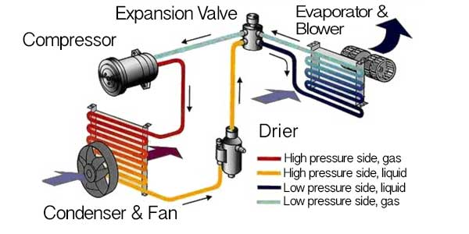
AC System & Sensors
Clutch On/Off
Engine RPM
Blower Speed
High Side Pressure
Evaporation Temperature
Fan Speed
Additional: Wiper Status, Ambient Air Temperature, Vehicle Acceleration, Vehicle Speed
*Reference: https://carhowto.com/how-your-cars-ac-system-works/

Slide 4
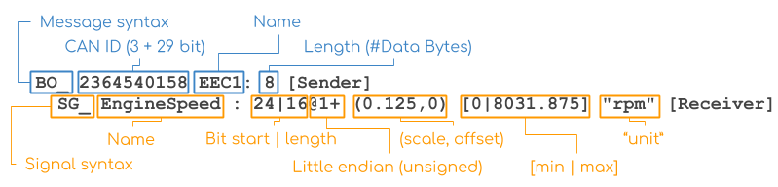
Big Data Drive (BDD) *:
Big Data Drive uses an Open XC plug-in device to record vehicle data.
The device is connected via the OBD II port and collects vehicle CAN data, which is then sent via Bluetooth to an onboard phone.
The phone then transmits the CAN data via WIFI (when the user connects while at home) or via cellular (select cases).
CAN messages are transmitted as encoded hexadecimal signals (ex. 0xcf390011030f0b0c) which then have to be decoded into human-readable values.
A DBC file encodes raw CAN vehicle data into a human-readable and standardized format. A vehicle may have multiple CAN buses (HS1/HS2/MS) and every CAN bus is represented by its own DBC file.
The image below shows the general structure of a DBC file - which is essentially a database format structured around messages and signals.
*Reference: https://github.ford.com/GDIA/ConnectedVehicleAnalytics/tree/master/BDD/decode

Slide 5
Approach
Since the theory is inhibits and recirc overrides could potentially lead to the increase of air temperatures, in this study we are using Big Data Drive to assess the theory:
Step 1: Look at 25 pre-2020 (MY 2018 & 2019) Explorers and 21 2020 Explorers, count the number of inhibits and recirc overrides for every 100 km per vin.
Below are three different CAN triggers available in BDD that will cause inhibits and recirc overrides.
How do the counting?
For Pedal position and Enrichment, when the event happened no matter for how long, count that event one time.
To make counting more meaningful, calculate the duration of the event for each 100 Km
Pre-processing steps:
Down sample to one decimal after point for epoch (Unix time) - do average for the aggregation
Due to different time aliment after creating column for each signal, many NULL has been created. Fill those NULL with the previous value
CAN Trigger | Strategies
ApedPos_Pc_ActlArb > 50 | Wide Open Throttle
HvacAirFullOut_B_Rq = TRUE | Enrichment (Powertrain requests climate control draw outside air in to the passenger compartment.)
HvacCmprLim_D_Stat = 1 OR 2 OR 3 OR 4 OR 5 (not in pre-2020) | Compressor Limit Request (Indicates what is limiting the compressor to help Climate ECU make a determination in moving the recirculation door.)

Slide 6

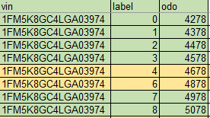
Challenges in Odometer Value Reading
For couple of VINs we see jump in the odometer value, what the issue is:
For those cases that we see jump between 0 to some other number rather than 1 like below example in yellow, there is an issue in odometer reading since when I check the epoch at odometer 0 and epoch at odometer 4900 there is only few millisecond gaps. So, for these cases I will simply ignore 0.
For very few cases the epoch is not match with odometer as it should be (when the odometer increases the epoch should also increasing). So, there is a odometer value for 9000 at epoch 1234 but then there is odometer reading of 4000 at epoch 1236. This is suggesting 4000 one (which is only 2-3 epoch in total with odometer 4000) is outlier and usually the value for the other signals at those epochs were 0 or null.
For last cases where everything looks Okay but there are some gaps between odometer value like below example, it seems for some time no data has been transmitted or maybe it is missing. This does not have any impact on my calculation since we missed a block of data. When providing result in terms of % or count per 100 Km it would be okay.

Slide 7
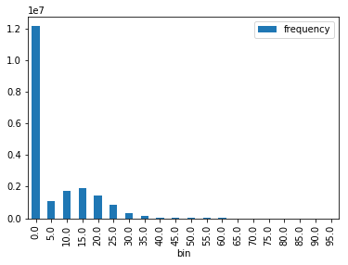
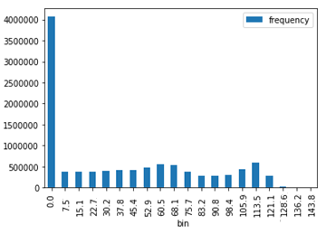
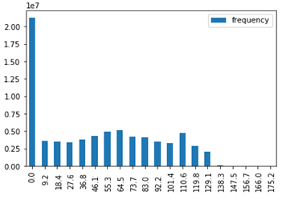
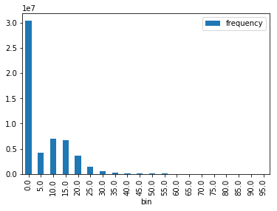
Other Challenges
Do we need to worry definition of trip in this study?
Is there any of the signals that keep publishing when engine is off?
Looking at distribution of couple of signals and duration of events per 100 km may answer above question
Distribution of Pedal Position for Explorer MY20
Distribution of Speed for Explorer MY20
Distribution of Speed for Explorer MY18-19
Distribution of Pedal Position for Explorer MY18-19
Speed (kmph)
Speed (kmph)
Pedal Position

Slide 8
Result for Frequency of event for each CAN Trigger:

Slide 9
MY 2020
Result of Event Count and Duration per 100 km for Each VIN:
MY 2018-2019

Slide 10
Result of Compressor Limit Request Status
Compressor Limit Request (indicates what is limiting the compressor to help Climate ECU make a determination in moving the recirculation door) has 5 status as: 1. ECT, 2. N, 3. Pedal, 4. Launch and 5. Pressure.
Since this signal is only available on 2020 Model Year, we bring separate analysis here.
For Climate Control team, status 3 has more value because it shows when the compressor is being cut out because of pedal position.
Compressor limit request due to pedal position (18% of all limit requests) happened for 8 VINs (out of total of 21 VINs of study) and there are two VINs (*20811, *20588) that 70% of total occurrence happened for them.
70% belong to 2 VINs
These two drivers seem to be very heavy on the gas and looks like there are instances of compressor inhibit and recirc override happening at the same time.

Slide 11
Approach
Step 2: See if there’s any difference in real air temperatures, gap between request temperature and real temperature, recirc degree and AC pressure 30 second before and after the CAN Trigger events happen (ApedPos_Pc_ActlArb > 50, HvacAirFullOut_B_Rq = TRUE & HvacCmprLim_D_Stat = 1 OR 2 OR 3 OR 4 OR 5)
CAN Signal | Detail
HvacEvap_Te_Actl | Real air temperature
HvacEvap_Te_Actl – HvacEvap_Te_Rq | Gap between request temperature and real temperature
HvacRec_Pc_Est(not in pre-2020) | Recirc position
AirCondFluidHi_P_Actl | A/C pressure on the output side of the compressor
30 sec
30 sec
t
t+X

Slide 12
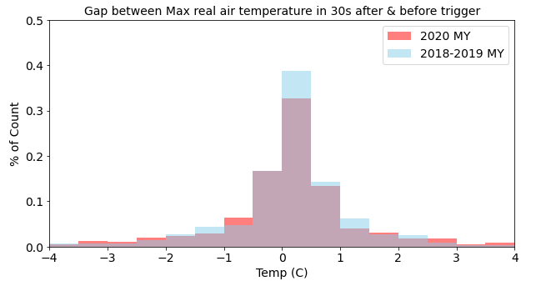
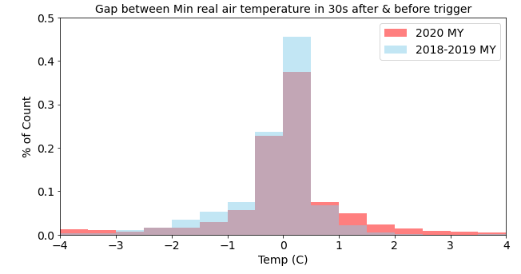
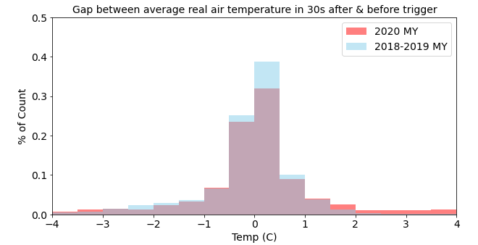
Pedal Position > 50
CAN Signal | Detail | Measurement
HvacEvap_Te_Actl | Real air temperature | Avg (Real air temperature in 30s after trigger) – Avg (Real air temperature in 30s before trigger) Min (Real air temperature in 30s after trigger) – Min (Real air temperature in 30s before trigger) Max (Real air temperature in 30s after trigger) – Max (Real air temperature in 30s before trigger)
Notes:
Legend axis label bigger bolder/grid lines overlap of color

Slide 13
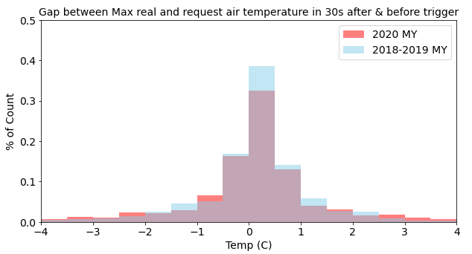
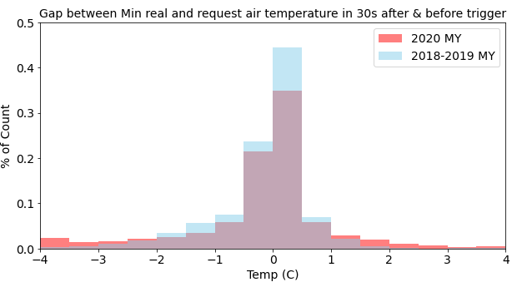
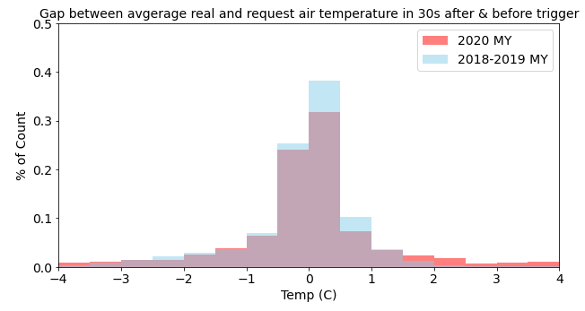
Pedal Position > 50
CAN Signal | Detail | Measurement
Gap_Actl_Rq=HvacEvap_Te_Actl – HvacEvap_Te_Rq | Gap between request temperature and real temperature | Avg (Gap_Actl_Rq 30s after trigger) – Avg (Gap_Actl_Rq 30s before trigger) Min (Gap_Actl_Rq 30s after trigger) – Min (Gap_Actl_Rq 30s before trigger) Max (Gap_Actl_Rq 30s after trigger) – Max (Gap_Actl_Rq 30s before trigger)
Notes:
Legend axis label bigger bolder/grid lines overlap of color

Slide 14
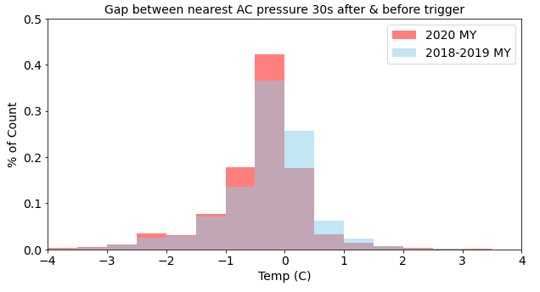
Pedal Position > 50
CAN Signal | Detail | Measurement
AirCondFluidHi_P_Actl | A/C pressure on the output side of the compressor | Nearest (Real AC pressure after trigger) – Nearest (Real AC pressure before trigger)
AC pressure on the output side of the compressor after event trigger (Pedal Position > 50) for 2020 Explorer is smaller than before event.
Notes:
Legend axis label bigger bolder/grid lines overlap of color

Slide 15
Pedal Position > 50
CAN Signal | Detail
HvacRec_Pc_Est (not in pre-2020) | Recirc position | Avg (Recirc position in 30s after trigger) – Avg (Recirc position in 30s before trigger)
In this study over 99% of the time, recirc before and after trigger is at the same position
Notes:
Legend axis label bigger bolder/grid lines overlap of color

Slide 16
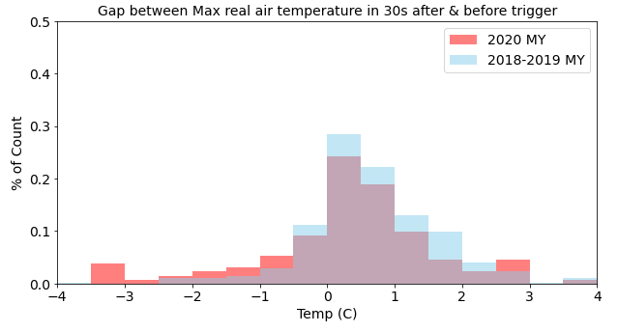
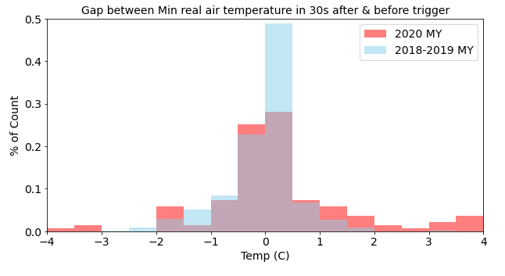
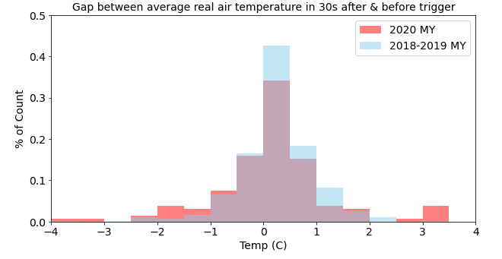
Enrichment = TRUE
CAN Signal | Detail | Measurement
HvacEvap_Te_Actl | Real air temperature | Avg(Real air temperature in 30s after trigger) - Avg(Real air temperature in 30s before trigger) Min(Real air temperature in 30s after trigger) - Min(Real air temperature in 30s before trigger) Max(Real air temperature in 30s after trigger) - Max(Real air temperature in 30s before trigger)
Notes:
Legend axis label bigger bolder/grid lines overlap of color

Slide 17
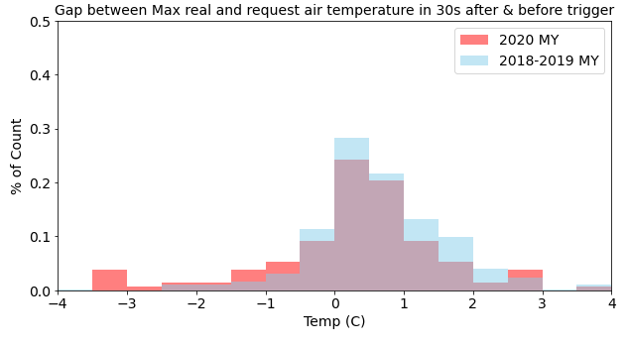
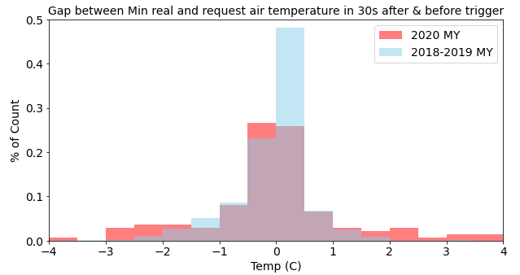
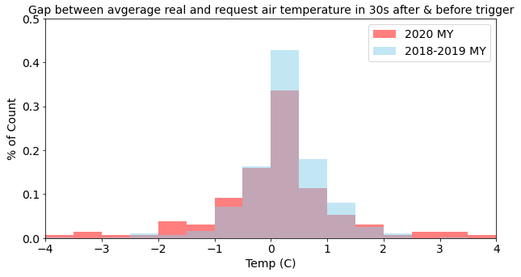
Enrichment = TRUE
CAN Signal | Detail | Measurement
Gap_Actl_Rq=HvacEvap_Te_Actl – HvacEvap_Te_Rq | Gap between request temperature and real temperature | Avg (Gap_Actl_Rq 30s after trigger) - Avg (Gap_Actl_Rq 30s before trigger) Min (Gap_Actl_Rq 30s after trigger) - Min (Gap_Actl_Rq 30s before trigger) Max (Gap_Actl_Rq 30s after trigger) - Max (Gap_Actl_Rq 30s before trigger)
Notes:
Legend axis label bigger bolder/grid lines overlap of color

Slide 18
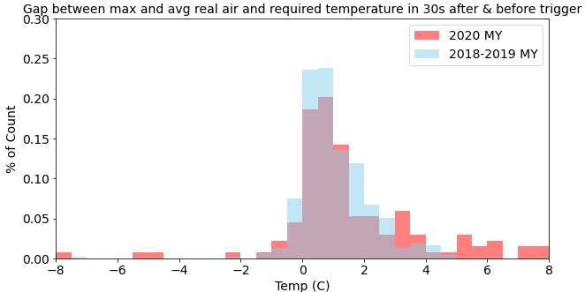
Enrichment = TRUE
CAN Signal | Detail | Measurement
Gap_Actl_Rq=HvacEvap_Te_Actl – HvacEvap_Te_Rq | Gap between request temperature and real temperature | Max (Gap_Actl_Rq 30s after trigger) - Avg (Gap_Actl_Rq 30s before trigger)
Notes:
Legend axis label bigger bolder/grid lines overlap of color

Slide 19
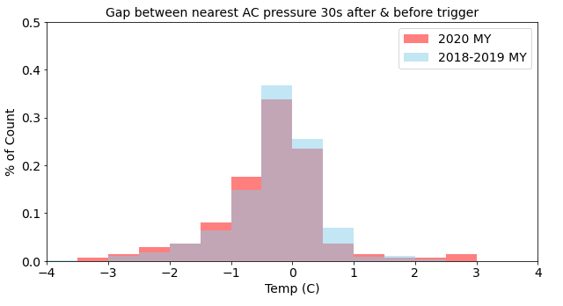
Enrichment = TRUE
CAN Signal | Detail | Measurement
AirCondFluidHi_P_Actl | A/C pressure on the output side of the compressor | Nearest (Real AC pressure after trigger) – Nearest (Real AC pressure before trigger)
AC pressure on the output side of the compressor after event trigger (Enrichment= TRUE) for 2020 Explorer is smaller than before event.
Notes:
Legend axis label bigger bolder/grid lines overlap of color

Slide 20
Enrichment = TRUE
CAN Signal | Detail
HvacRec_Pc_Est (not in pre-2020) | Recirc position | Avg(Recirc position in 30s after trigger)- Avg(Recirc position in 30s before trigger)
In this study over 99% of the time, recirc before and after trigger is at the same position
Notes:
Legend axis label bigger bolder/grid lines overlap of color

Slide 21
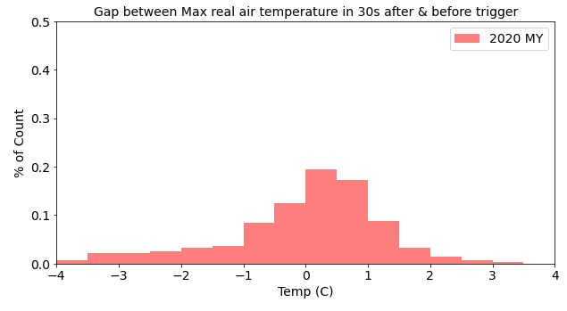
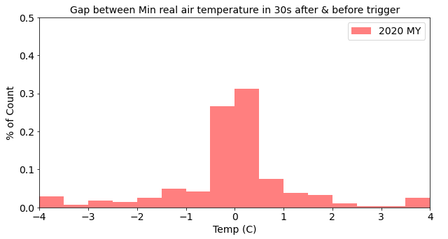
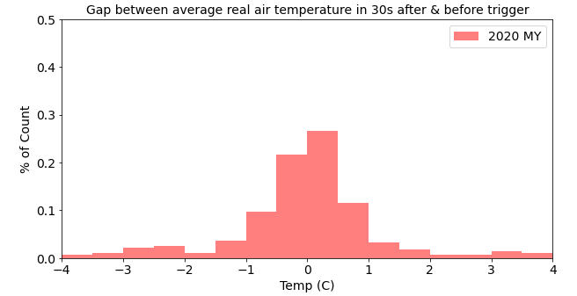
Compressor Limit Request = 1 OR 2 OR 3 OR 4 OR 5 (not in pre-2020)
CAN Signal | Detail | Measurement
HvacEvap_Te_Actl | Real air temperature | Avg(Real air temperature in 30s after trigger)- Avg(Real air temperature in 30s before trigger)
Notes:
Legend axis label bigger bolder/grid lines overlap of color

Slide 22
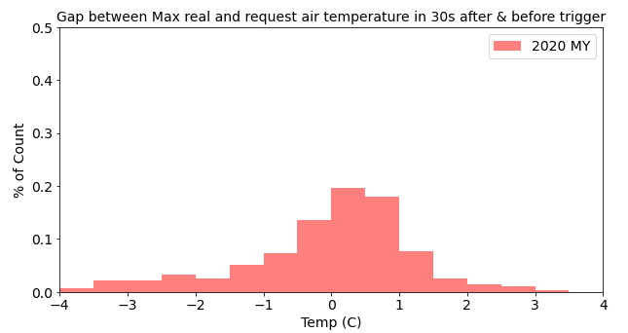
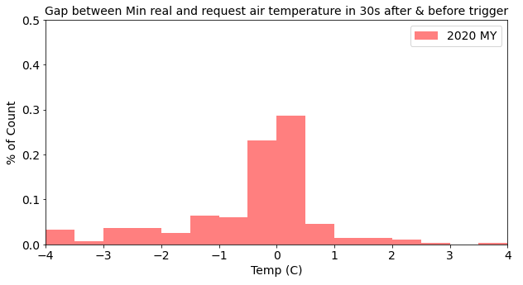
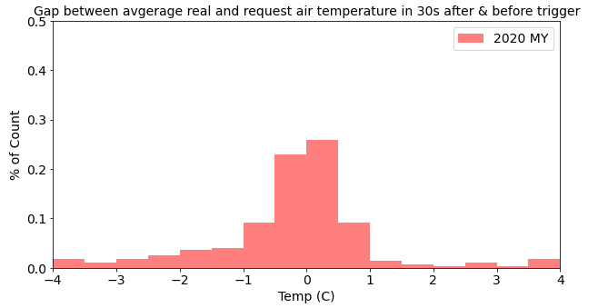
Compressor Limit Request = 1 OR 2 OR 3 OR 4 OR 5 (not in pre-2020)
CAN Signal | Detail | Measurement
HvacEvap_Te_Actl – HvacEvap_Te_Rq | Gap between request temperature and real temperature | Avg (Real Temp 30s after trigger – Req Temp 30s after trigger) – Avg (Real Temp 30s before trigger – Req Temp 30s before trigger)
Notes:
Legend axis label bigger bolder/grid lines overlap of color

Slide 23
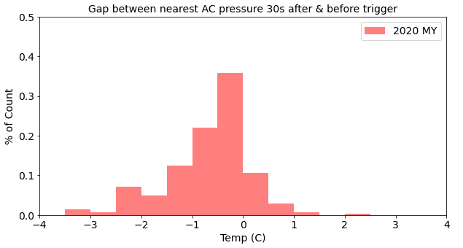
Compressor Limit Request = 1 OR 2 OR 3 OR 4 OR 5 (not in pre-2020)
CAN Signal | Detail | Measurement
AirCondFluidHi_P_Actl | A/C pressure on the output side of the compressor | Nearest(Real AC pressure after trigger)- Nearest(Real AC pressure before trigger)
AC pressure on the output side of the compressor after event trigger (Compressor Limit Request) for 2020 Explorer is smaller than before event.
Notes:
Legend axis label bigger bolder/grid lines overlap of color

Slide 24
Compressor Limit Request = 1 OR 2 OR 3 OR 4 OR 5 (not in pre-2020)
CAN Signal | Detail
HvacRec_Pc_Est(not in pre-2020) | Recirc position | Avg (Recirc position in 30s after trigger) – Avg (Recirc position in 30s before trigger)
In this study over 99% of the time, recirc before and after trigger is at the same position
Notes:
Legend axis label bigger bolder/grid lines overlap of color

Slide 25
Next Steps
Decode more signals and study the behavior of those
Repeat the study on more VINs
Any cost analysis information on compressors issue for Explorer would be beneficial
How Climate team would benefit from this study?

